Slide 1
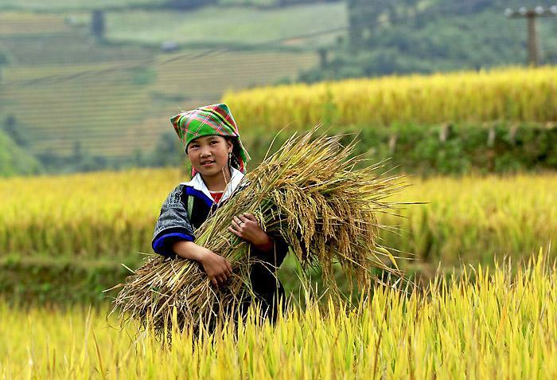
Right Crop My Right
Team Name : Maven Vane
Team Members :
Amandeep Singh
Vibhaas kotwal
Balamurugan P

Slide 2
Problem Statement
High climate variability in farming environment depresses right Crop productivity and constrain investments in agricultural sector
Agricultural livelihood system with the prevailing climatic variability requires availability of information on climate, weather and geographical footprint that will yield better benefits for the farmers using Machine Learning

Slide 3
SOLUTION METHODOLOGY
Define
Scope Crop production across districts over last 5 years
Diagnose
Crop Production: district wise, crop wise, season wise and year wise data on crop covered area and production.
How will it be Diagnosed? Indian Government Data – Crop Yield, Crop Area & Rains
Design
Descriptive Analysis
Classifier (Decision Tree, Logistic regression)
Evaluation Techniques

Slide 4
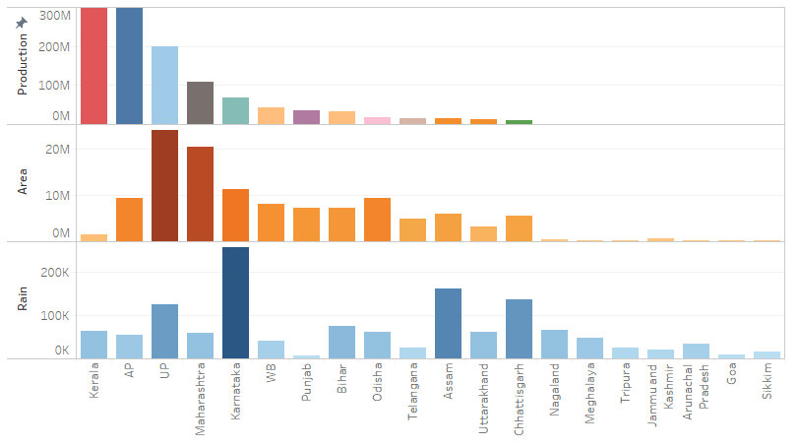
Comparative study: Crop yield vs. Resources

Slide 5
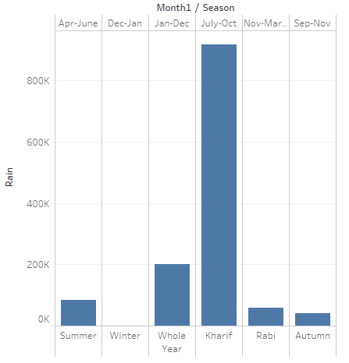
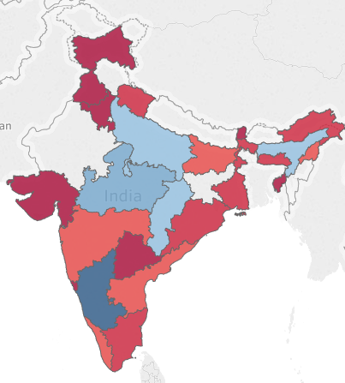
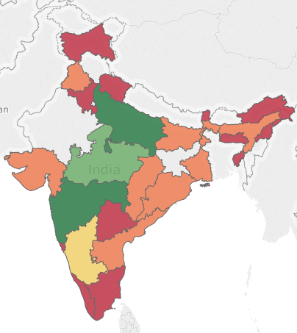
Rainfall and Crop Area
Original volume of data from Data.gov.in was 15 years. This is reduced to only 5 years for analysis and processing in limited time.

Slide 6
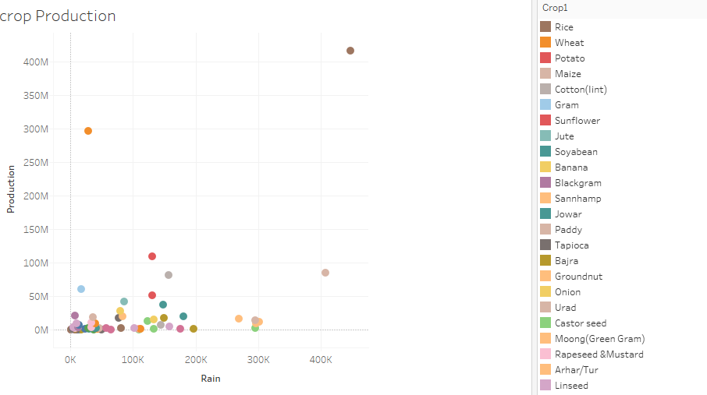
Crop Variety
*Coconut and Sugarcane are the outliers with most Production with less water

Slide 7





Architecture
Visualize
Imputation
Pre Processing
Step 1
Pre Processing
Step 2
Modeling
Decision Tree
Logistic Regression
60%/40%

Slide 8
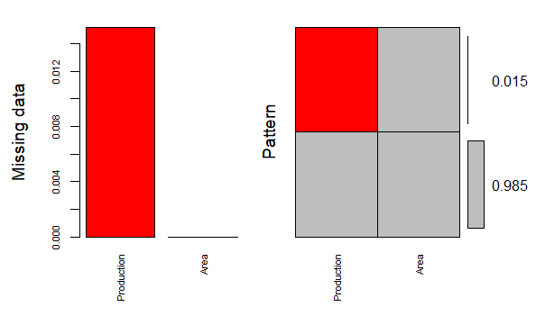
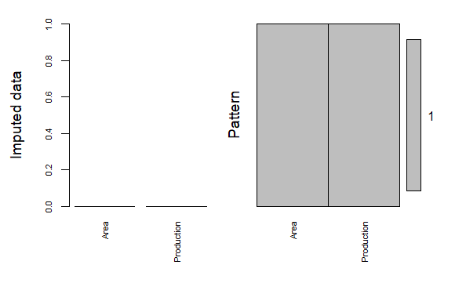
IMPUTATION (pmm)

Slide 9
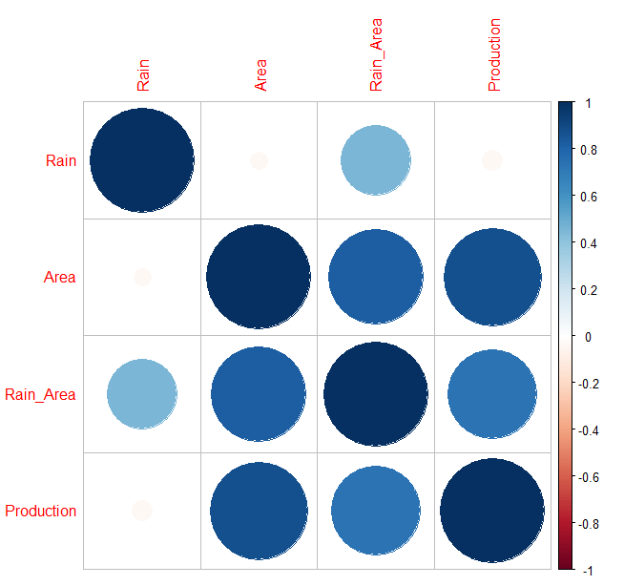
Correlation

Slide 10
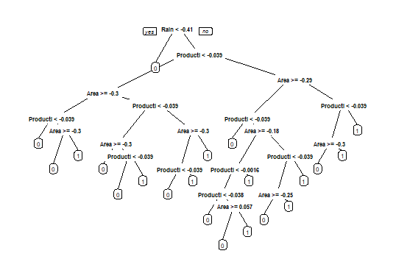
Decision Tree
TRAIN (60%)
31418
TEST (60%)
20945

Slide 11
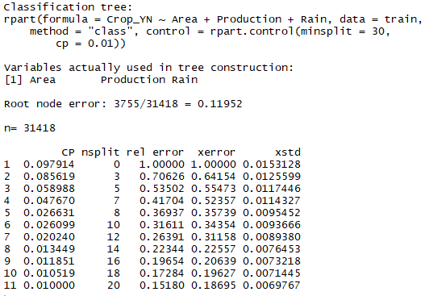
OPTIMAL TREE

Slide 12
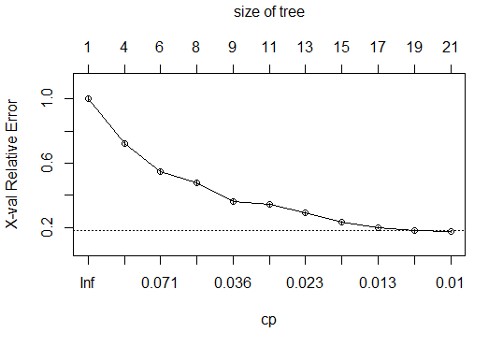
OPTIMAL TREE - COMPLEXITY PARAMETER

Slide 13
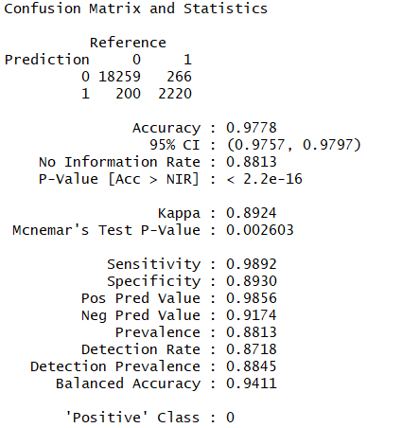
MODEL EVALUATION

